Slide 1


Distributed file system as a basis of data-intensive computing
CSE 707 Paper Review
Shakib Mahmud Dipto [22166030]
Nadia Tasnim Mim [22366021]

Slide 2
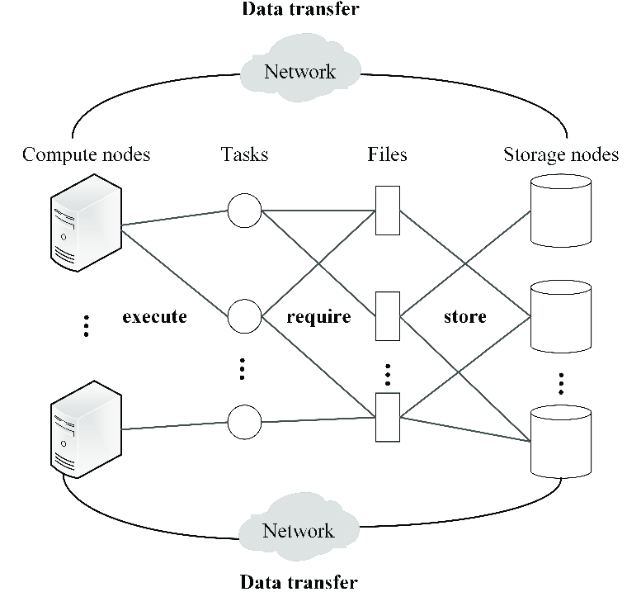
Introduction
Data Intensive Computing
Distributed file system
Big Data
Why big data become so big?
Speaker 1 ID: 22366021
1

Slide 3
Distributed File System(DFS)
As there has been exceptional growth in network-based computing, client/server-based applications have brought revolutions in the process of building distributed file systems.
Reason to Use:
Read large files fast.
Tolerance.
Efficient and Well managed data.
Transparency.
DFS was developed in the first place - the system can still have that integrity if a few workstations get moved around systems, like other systems, continue to innovate. With new kinds of networking controls and virtualization systems, modern DFS will often take advantage of logical partitioning or other advances in hardware and software. Ex: GFS (Google, 2003), HDFS (Apache Software Foundation, 2006).
Speaker 1 ID: 22366021
2

Slide 4
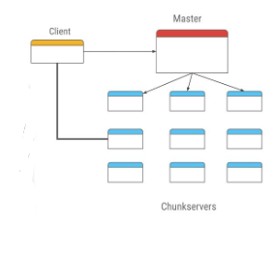
Google File System (GFS)
Platform created by tech giant Google.
Turned servers into a distributed, reliable and scalable system.
Key Features:
Serve cloud services effectively.
Provide extremely high read and transfer speed on
large files.
Data replications across the network.
Chunks of files into multiple chunk servers.
Chunks Index is controlled by a master server.
Speaker 1 ID: 22366021
3

Slide 5
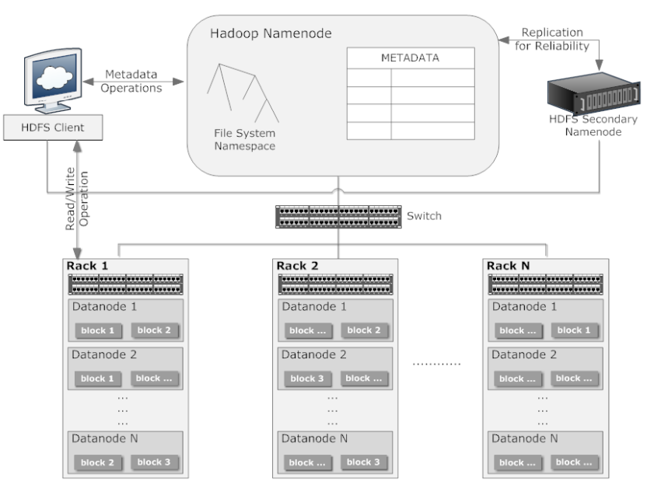
HADOOP Distributed File System (HDFS)
Similar as GFS
Difference with other DFS
High fault tolerance
Can be installed into low-cost hardware
Provides high throughput access
Suitable for apps with large database
Block level replication
Nodes:
Name Node
Data Node
Speaker 2 ID: 22166030
4

Slide 6
Cluster
A cluster is a group of interconnected computers or hosts that work together to support applications and middleware. It assigns the same tags to each node.
HADOOP Cluster
A special type of computer cluster
Limitation of HDFS
Not a POSIX file system
Not designed for small files
Do not support relational database
Do not focus of security or encryption
Speaker 2 ID: 22166030
5

